Slide 1

APOD
Using bluetooth/wireless designing and making a Lynxmotion A-Pod robot controller

Slide 2
Embedded System – Team 3
Team Member:
Phan Anh Dũng Cường – Team Leader
Nguyễn Minh Quân – Team member

Slide 3


ROBOT
10
Years ago

Slide 4


+

Slide 5
Over 100,000
types of robot today.
5 main types
Walking Robots
Flying Robots
Wheeled Robots
Snake Robots
Wall Climbing Robots

Slide 6
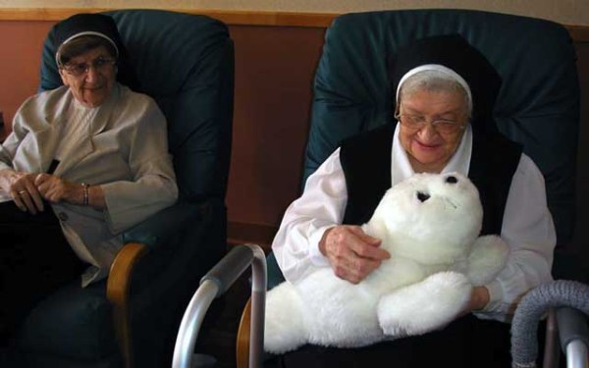
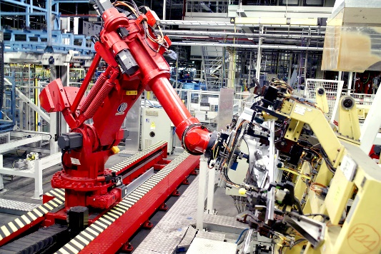
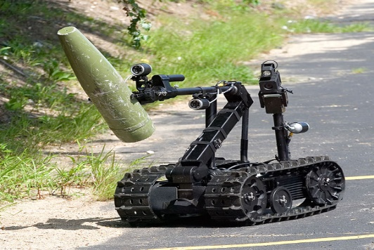
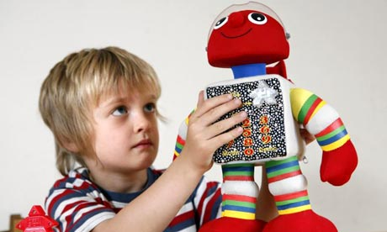
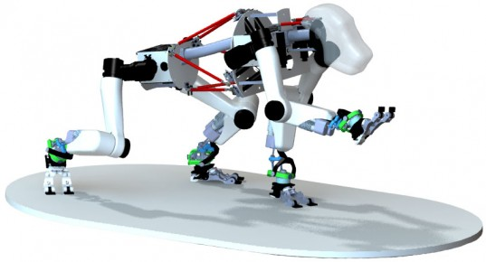
Robot
Therapeutic
Industrial
Military
Education
Research

Slide 7
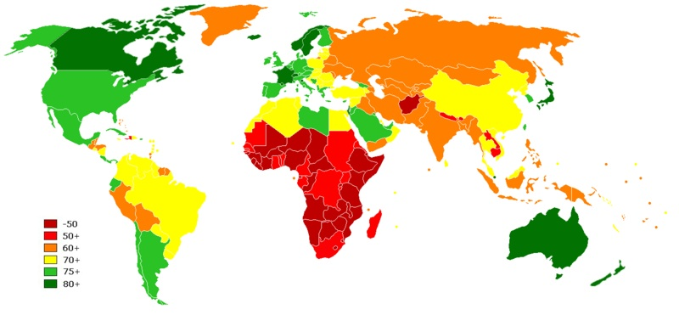
Robot’s Density World Map

Slide 8
INTRODUCE

Slide 9
Introduce
Hexapod
Apod
What’s Include?
Servos
Modules Control
SSC32
STM32F4
Ultrasonic Sensor
PC Control Interface
How’s difference?
What did they do?
What did we do?
How do we do?
Algorithm
Demo
Pros and cons
Are there anything to be programmed in the future?

Slide 10
Hexapod
A hexapod robot is a mechanical vehicle that walks on six legs. Since a robot can be statically stable on three or more legs, a hexapod robot has a great deal of flexibility in how it can move.
Many hexapod robots are biologically inspired by Hexapoda locomotion.
Uses:
Test biological theories about insect locomotion.
Motor control.
Neurobiology.

Slide 11
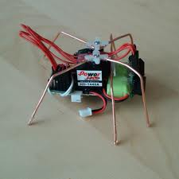
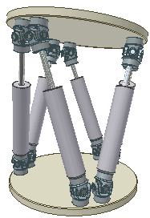
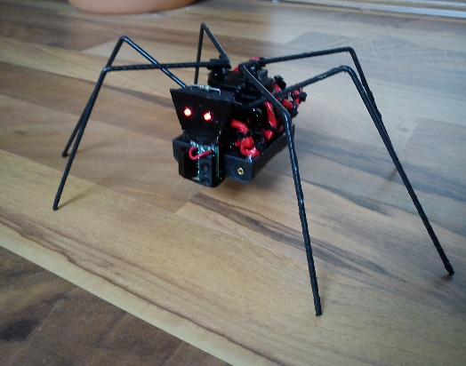
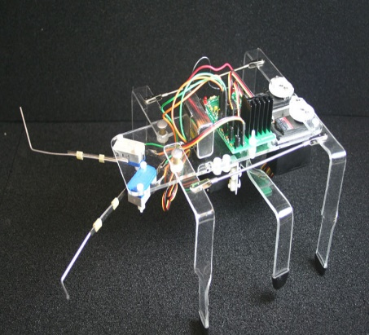
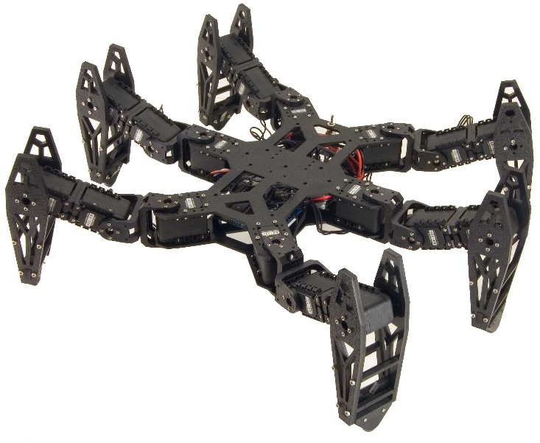
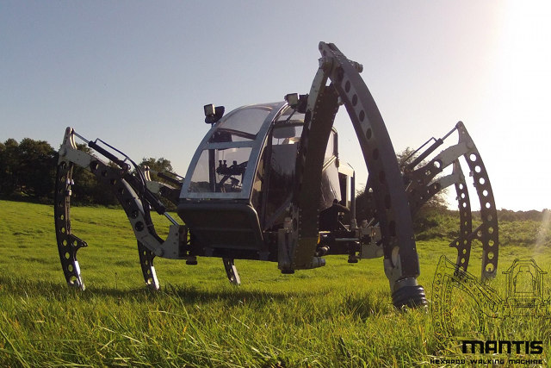
World of Hexapods

Slide 12
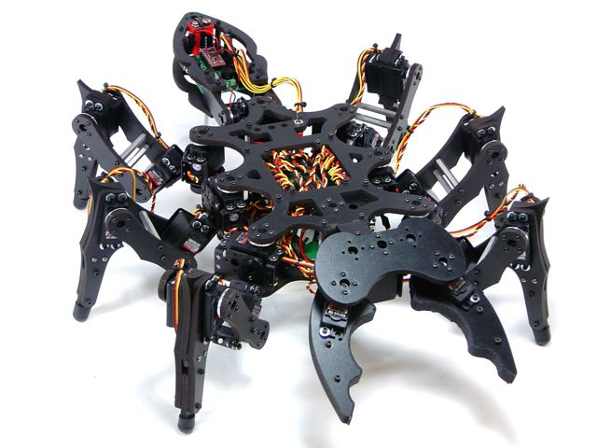
What is our project?
Hexapod
APOD

Slide 13
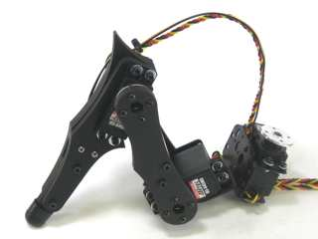
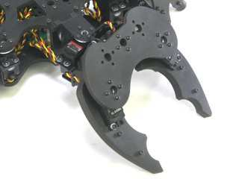
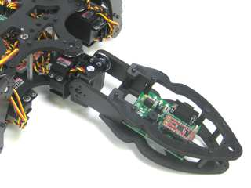
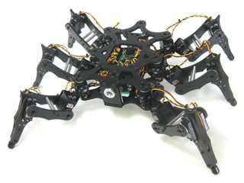
Apod
25 Servos
This is 3DOF hexapod
Prototype of incest robot
Include:
6 legs
1 head with Gripper
1 tail
1 body
3 Servos/ Leg
3 Servos
Vertical
Horizontal
Rotate
2 Servos

Slide 14
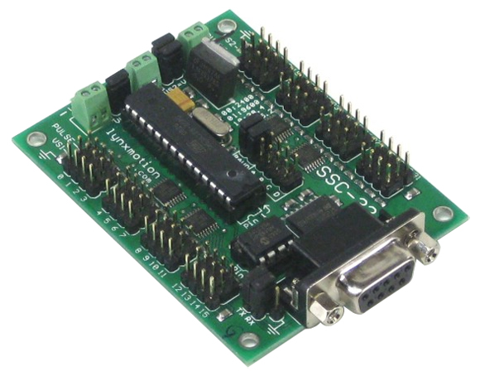
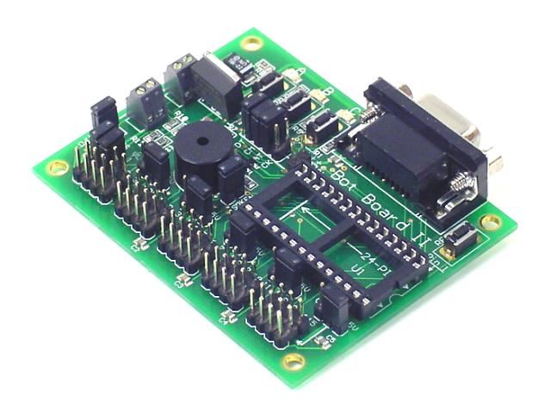
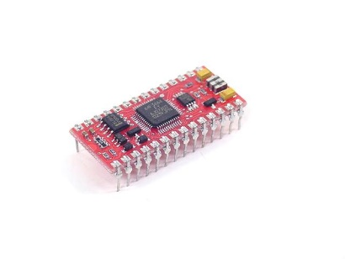
Their Apod
SSC32
BOTBOARD II

Slide 15
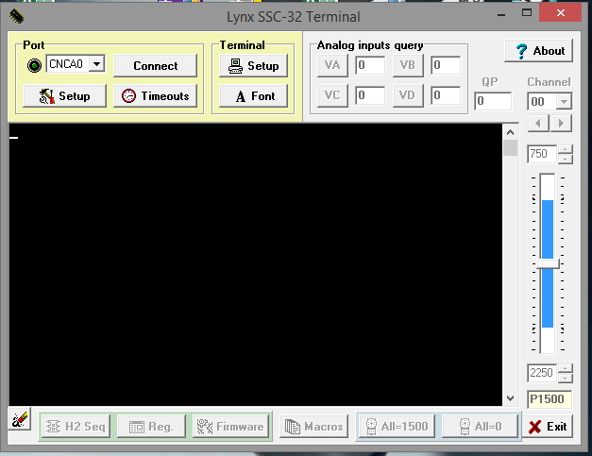
Their Apod

Slide 16
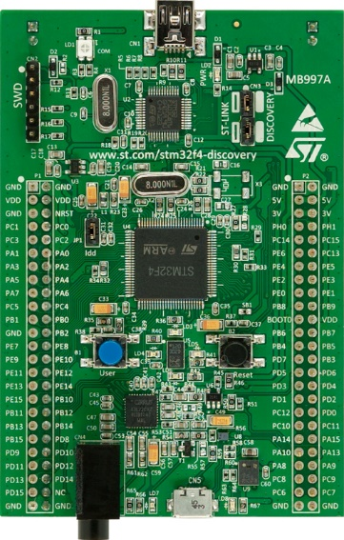
Our Apod
SSC32
STM32F4

Slide 17
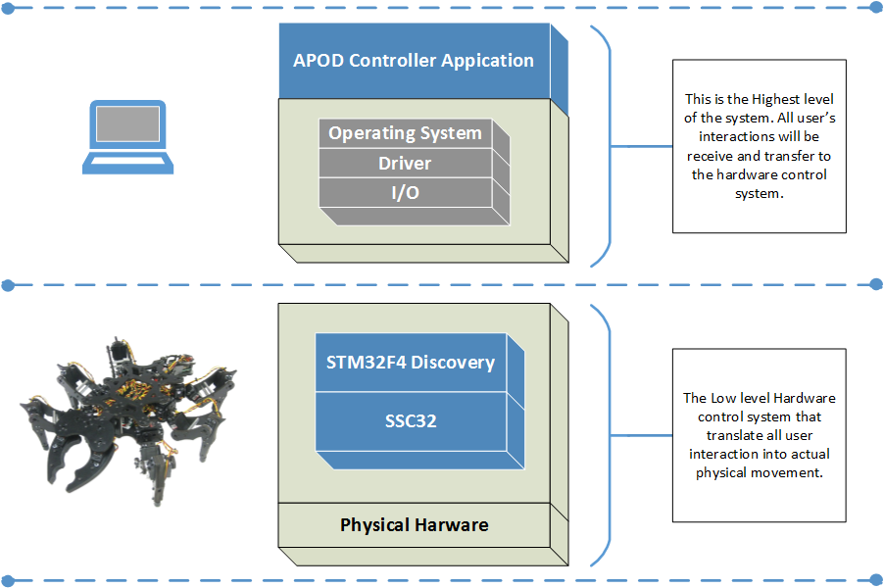
Architecture

Slide 18
Components & Modules

Slide 19
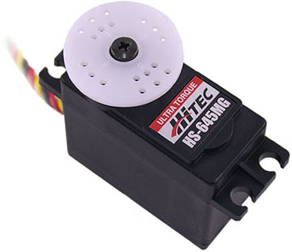
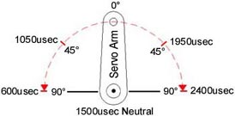
Servos
Control System: +Pulse Width Control 1500usec Neutral
Required Pulse: 3-5 Volt Peak to Peak Square Wave
Operating Voltage: 4.8-6.0 Volts Operating Angle: 45 Deg. one side pulse traveling 400usec

Slide 20
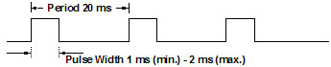
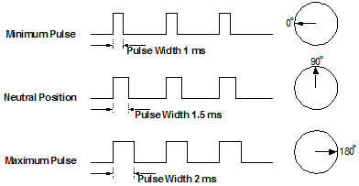
How’s Servo works?

Slide 21
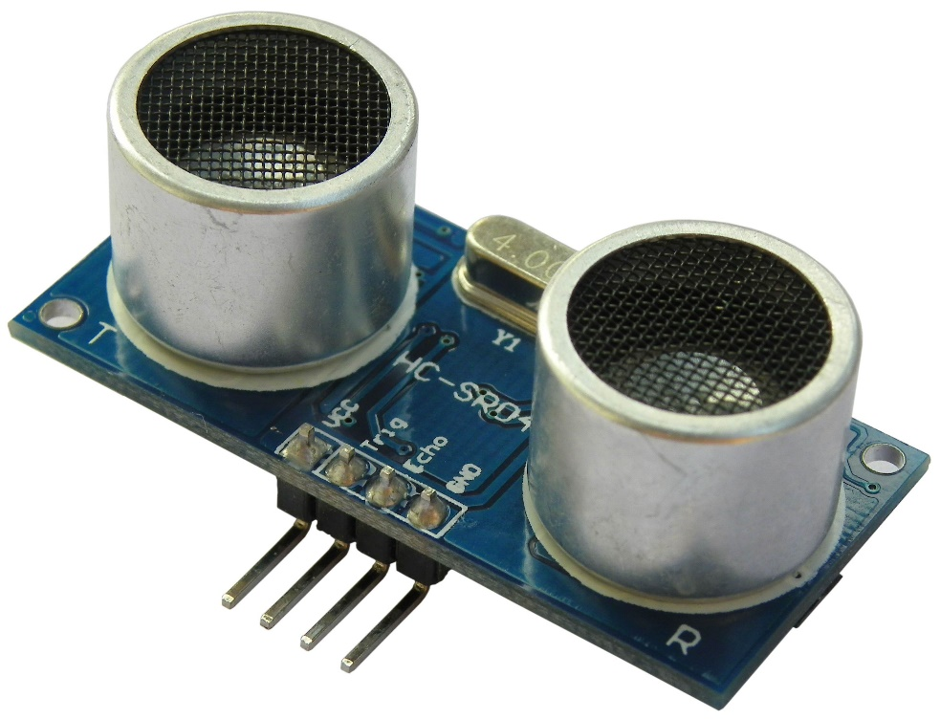
Ultrasonic Sensor HC-SR04
Working Voltage DC 5 V
Working Current 15mA
Working Frequency 40Hz
Max Range 4m
Min Range 2cm
Measuring Angle 15 degree
Trigger Input Signal 10uS TTL pulse
Echo Output Signal Input TTL lever signal
and the range in proportion
Dimension 45*20*15mm

Slide 22
Module Control
SSC32
STM32F4 DISCOVERY

Slide 23
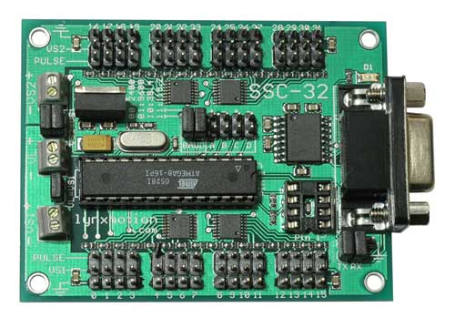
SSC32
Microcontroller = Atmel ATMEGA168-20PU
EEPROM = 24LC32P (Required for 2.01GP)
Speed = 14.75 MHz
Internal Sequencer = 12 Servo Hexapod (Alternating Tripod)
Serial input = True RS-232 or TTL, 2400, 9600, 38.4k, 115.2k, N81
Outputs = 32 (Servo or TTL)
Inputs = 4 (Static or Latching, Analog or Digital)
Current requirements = 31mA
PC interface = DB9F
Microcontroller interface = Header posts
Servo control = Up to 32 servos plug in directly
Servo type supported = Futaba or Hitec
Servo travel range = 180°
Servo resolution = 1uS, .09°
Servo speed resolution = 1uS / Second
Servo motion control = Immediate, Timed, Speed or Synchronized.
PC board size = 3.0" x 2.3"
VS current capacity = 15 amps per side, 30 amps maxm

Slide 24
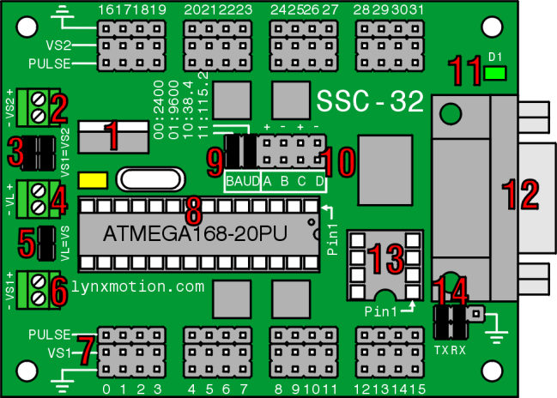
SSC32

Slide 25
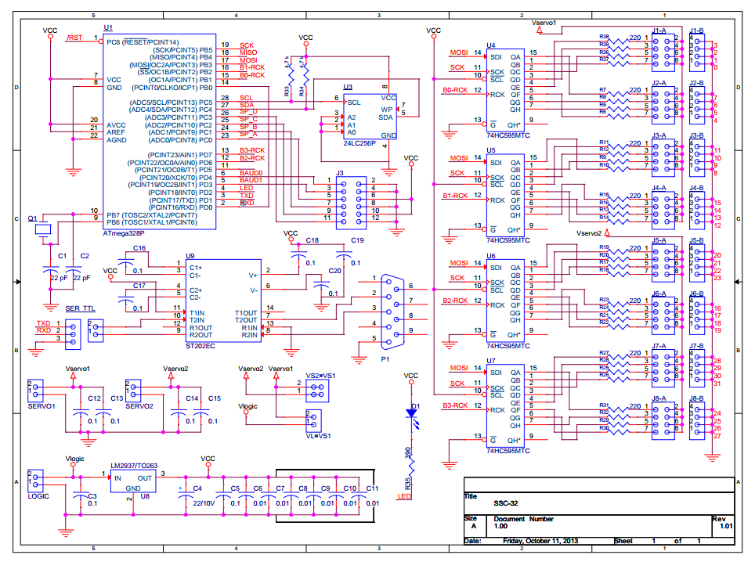
SSC32

Slide 26
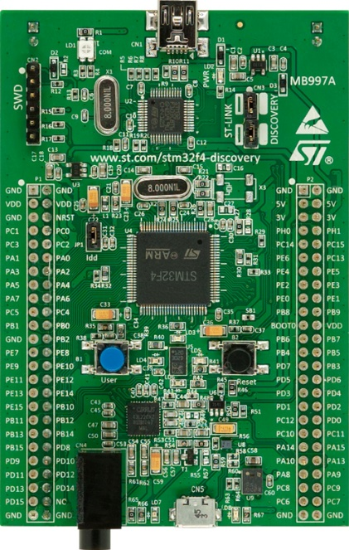
STM32F4
STM32F407VGT6 microcontroller featuring 32-bit ARM Cortex-M4F core,
1 MB Flash, 192 KB RAM in an LQFP100 package
Board power supply: through USB bus or from an external 5 V supply voltage
External application power supply: 3 V and 5 V
LIS302DL or LIS3DSH ST MEMS 3-axis accelerometer
MP45DT02, ST MEMS audio sensor, omni-directional digital microphone
CS43L22, audio DAC with integrated class D speaker driver

Slide 27
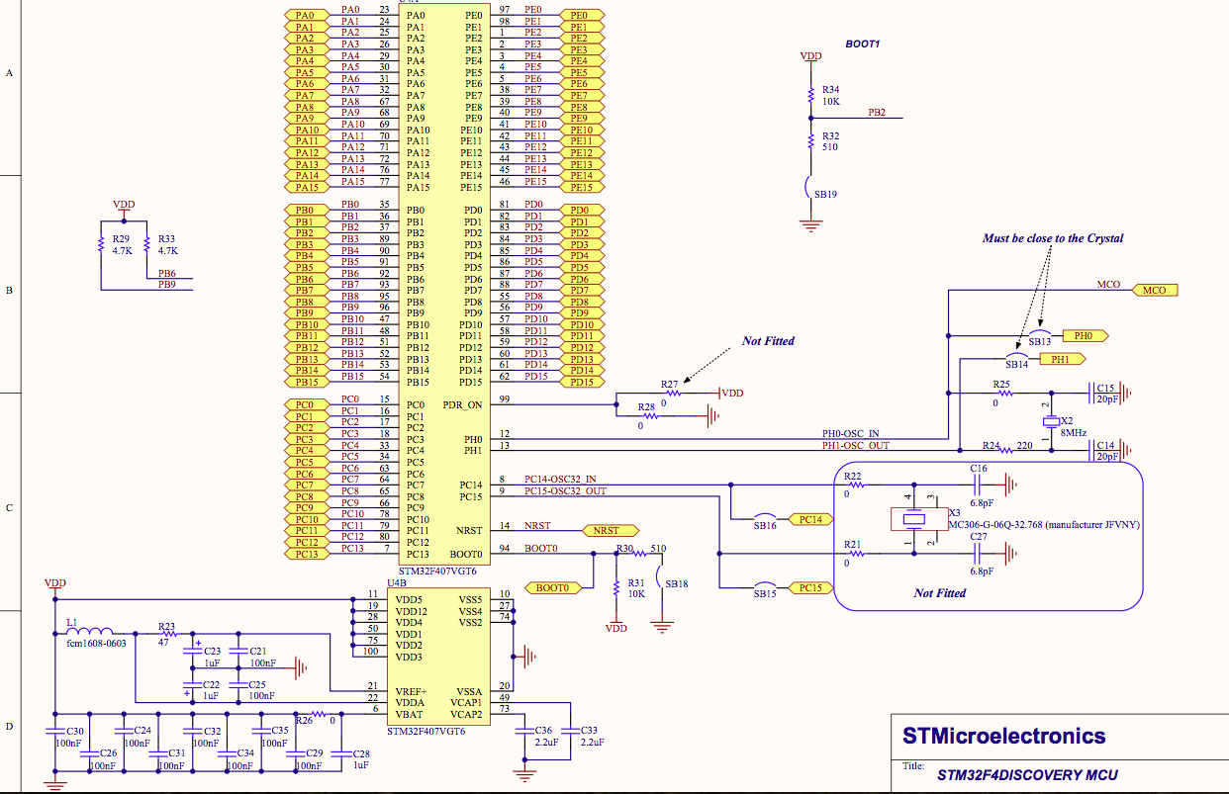

Slide 28
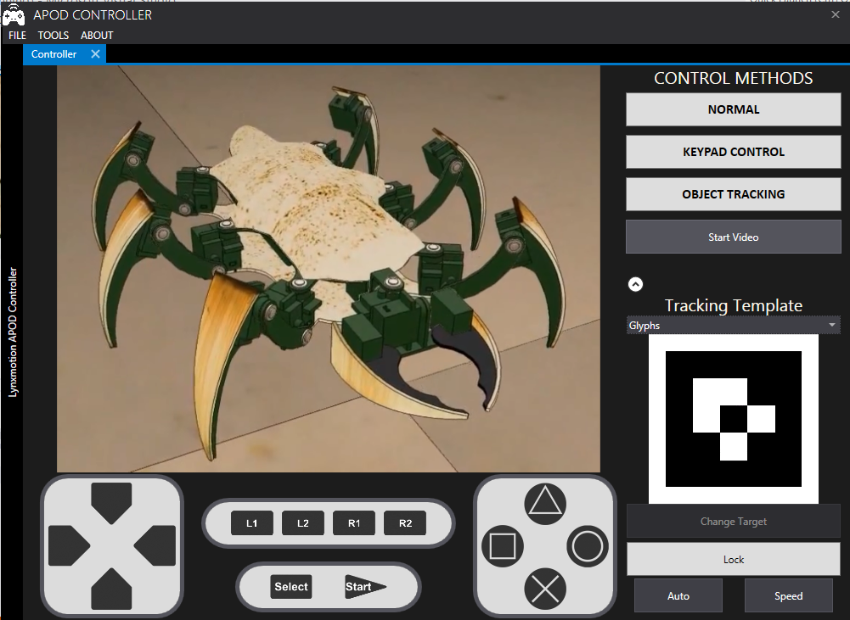
PC INTERFACE

Slide 29
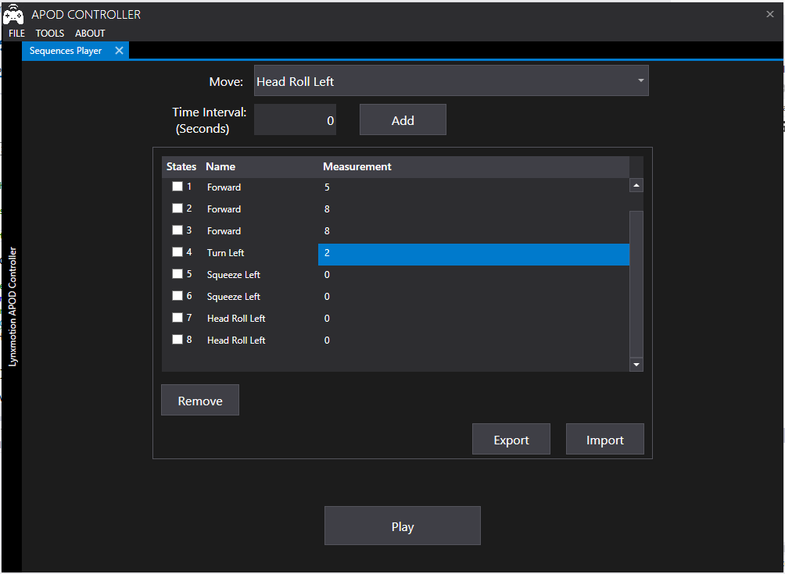
Sequence Player

Slide 30
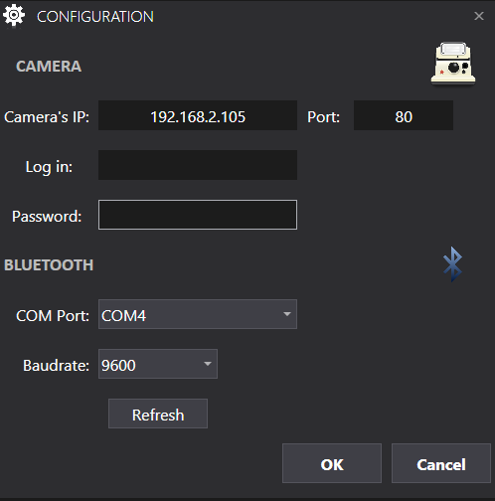
Configuration

Slide 31
How’s difference?

Slide 32
What did they do?
Apod (ONLY MANUAL CONTROL)
Movement (Left, Right, Forward, Backward, etc.)
Grip
Lift
Drop
Some crazy action
Controller
Using Wireless controller (2.4Ghz) direct connect with BOTII module
Brain
All algorithm embedded in BOTBOARD II
Another function
NONE

Slide 33
What did they do?
Video here

Slide 34
What did we do?
Apod (MANUAL AND AUTOMATIC)
Movement (Left, right, forward, backward, etc.)
Grip
Lift
Drop
Some crazy action
Controller
Using Bluetooth connect indirect through Pc interface, communicate with STM32F4
Brain
All algorithm embedded in STM32F4 discovery

Slide 35
What did we do? (cont)
Another function
Live camera with detect color
Automate redirect movement
Automate indentify distance between Apod and the item

Slide 36
Does we similar with others?
Built all implement from the begin
Firmware (SSC32)
Alternate module (STM32F4)
Just:
Depend on Algorithm which World’s done to create function
NO

Slide 37
What did we do? (cont)
Video here

Slide 38
How do we do?

Slide 39
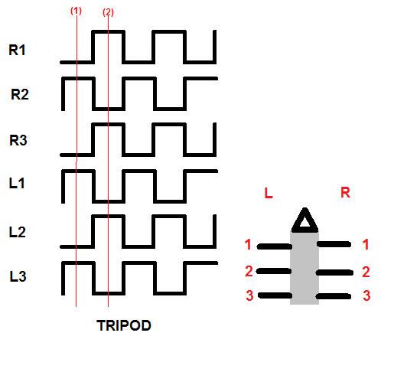
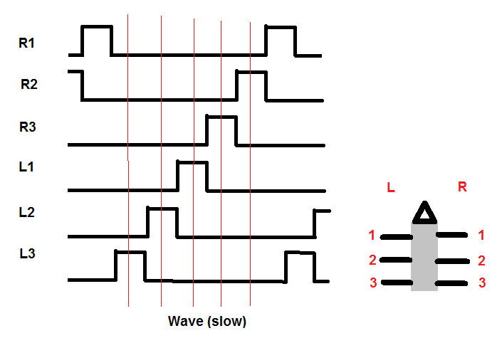
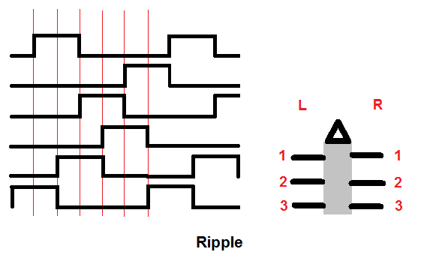
Type of Movement

Slide 40
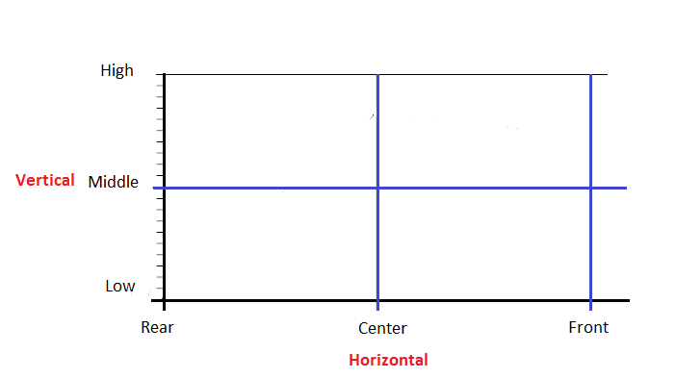
Legs Analysis

Slide 41
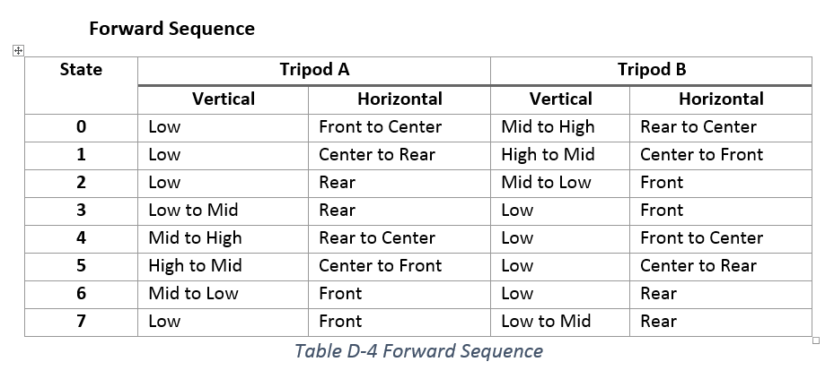
Legs Analysis

Slide 42
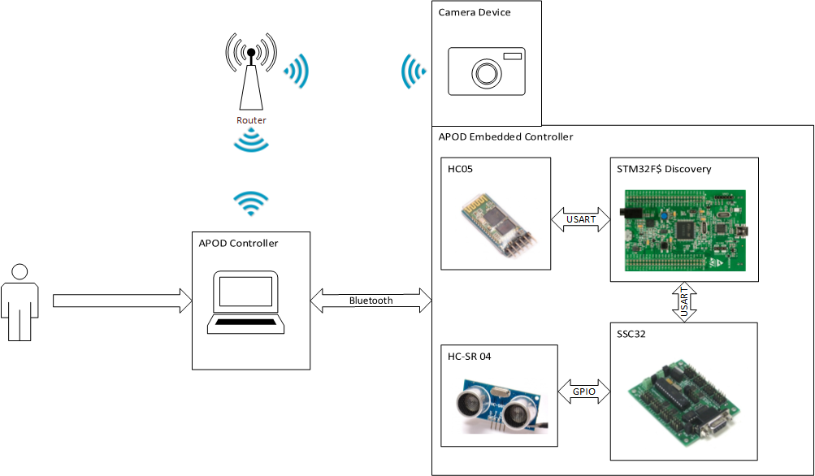
APOD Communication Mechanism

Slide 43
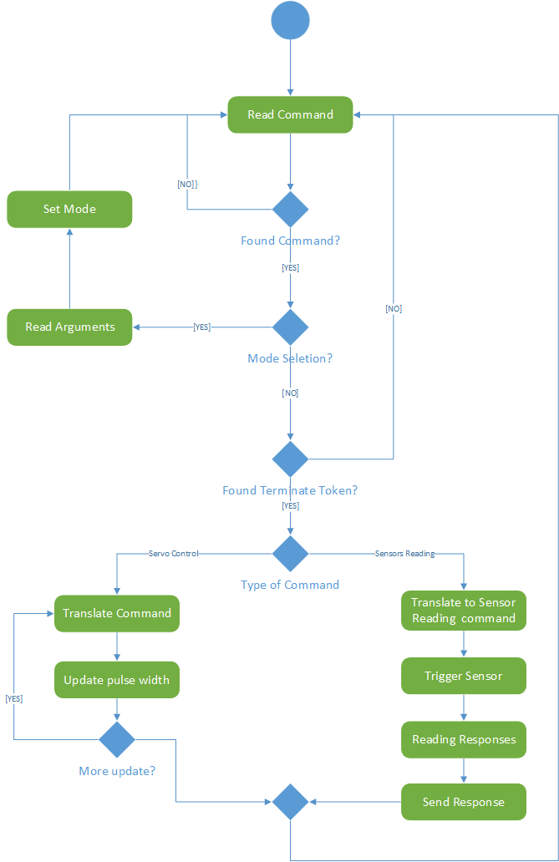
SSC32 Flowchart

Slide 44
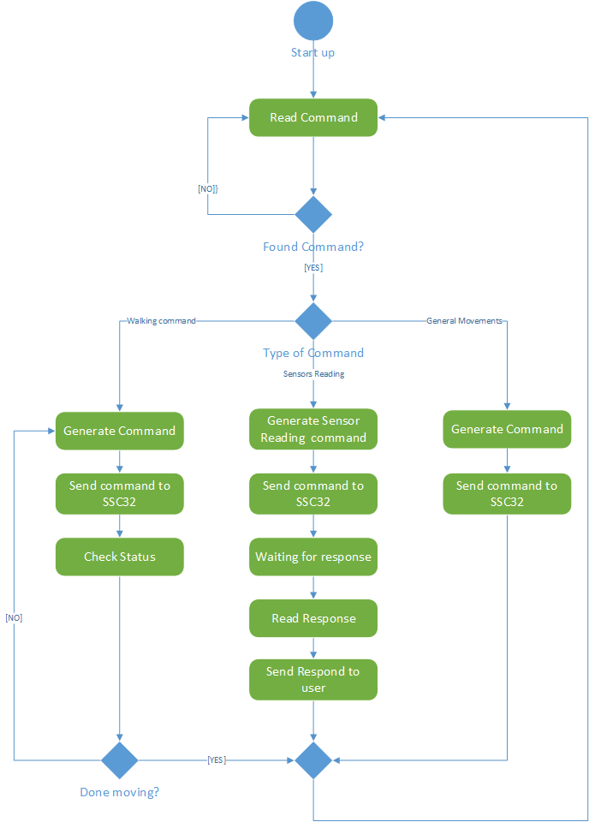
STM32F4 Flowchart

Slide 45
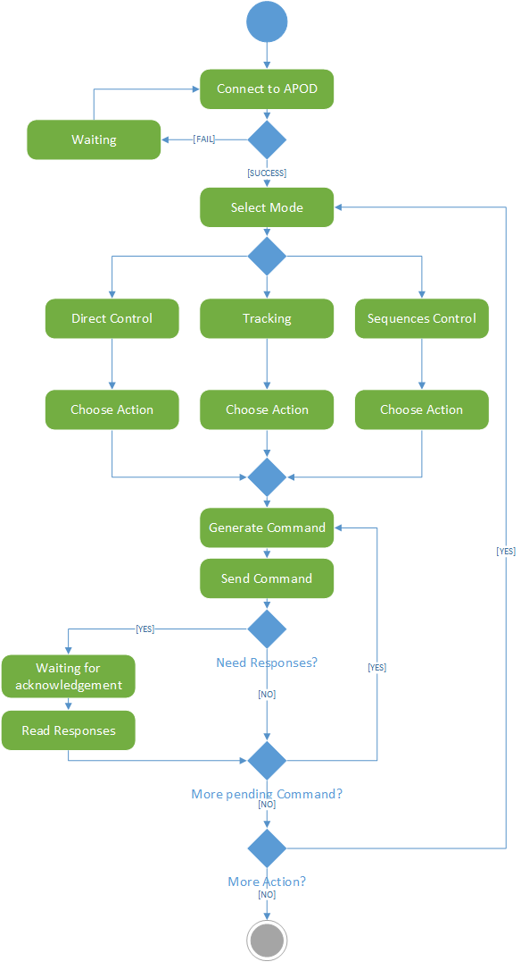
APOD Flowchart

Slide 46
Demo

Slide 47
Pros and cons
Short time to program
Hard to find hardware

Slide 48
Are there anything to be programmed in the future?
Automate in movement like the insect
Tracking function and find the way to return
Can hear and make some dancing in music
Able to walk on stair
Obey (can follow the owner, hear the order of owner, etc.)

Slide 49
END

